Slide 1

Introduction to HIVE

Slide 2
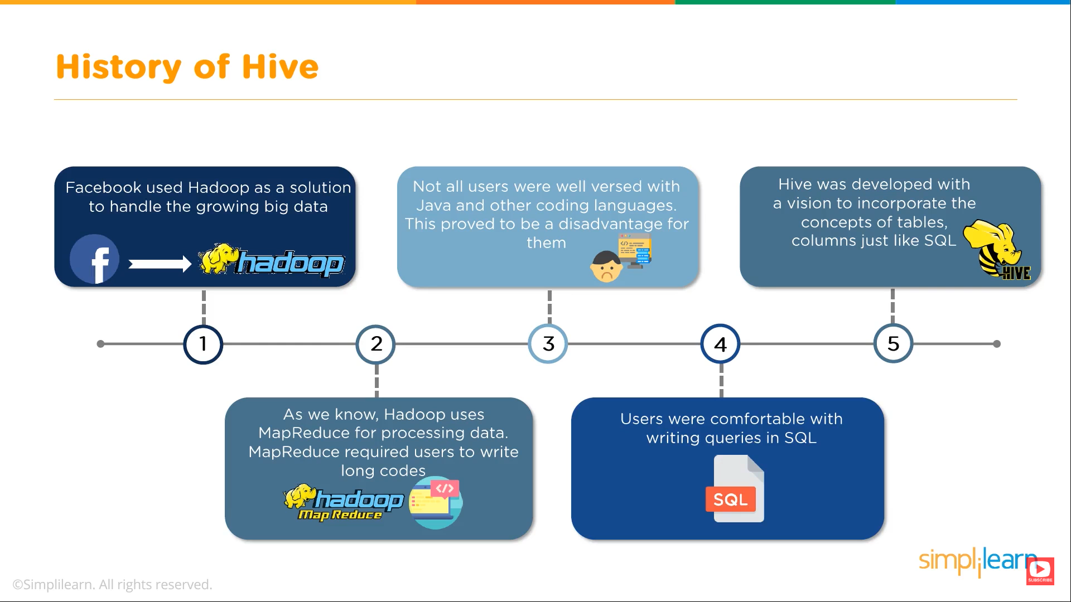


Slide 3
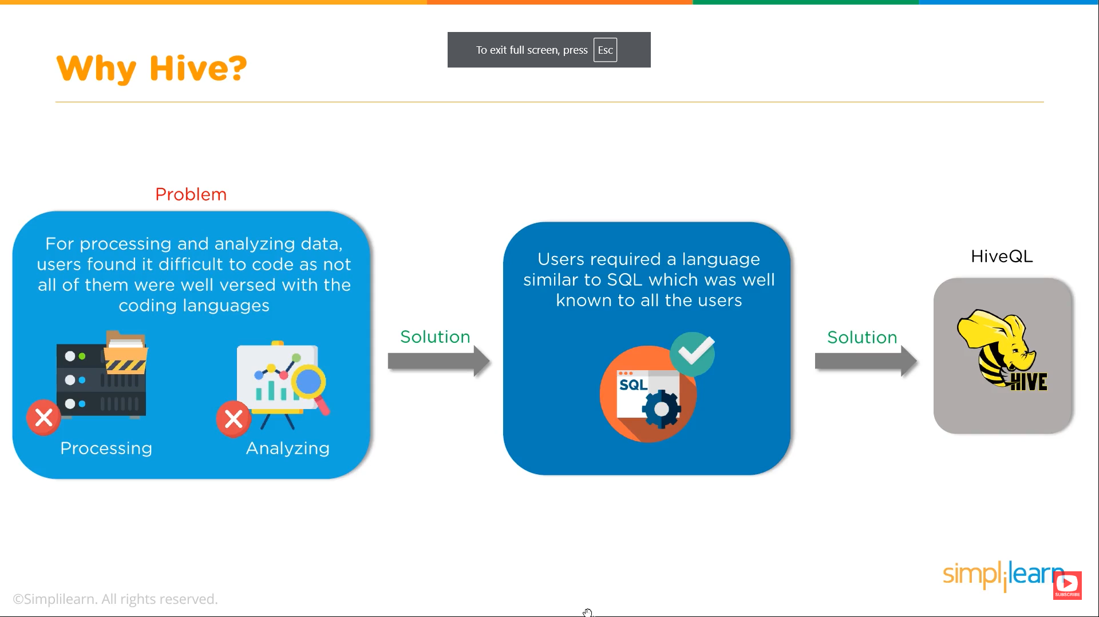


Slide 4
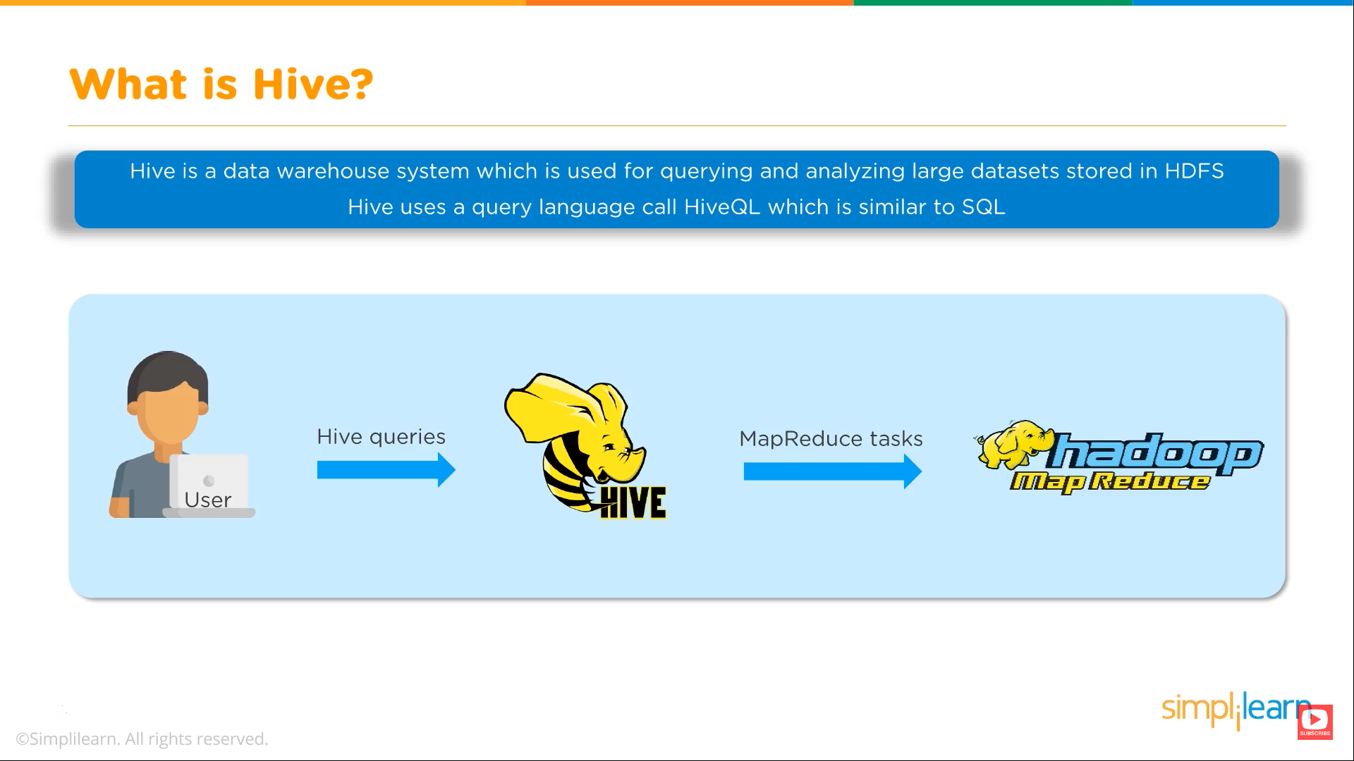

Slide 5

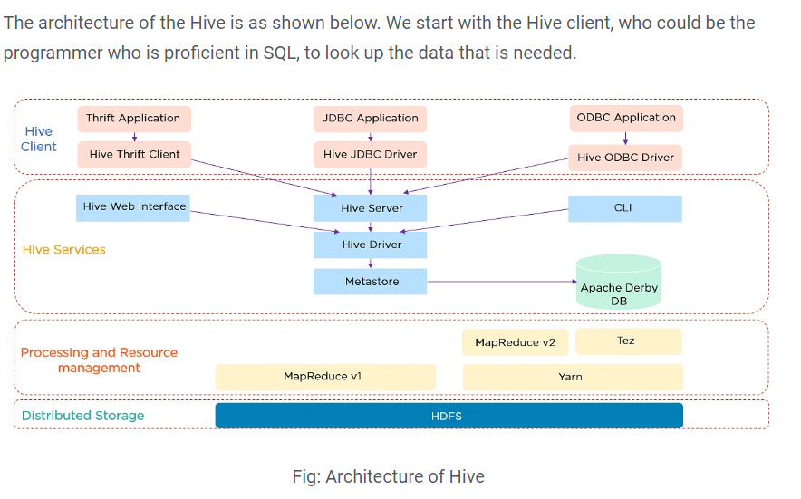

Slide 6
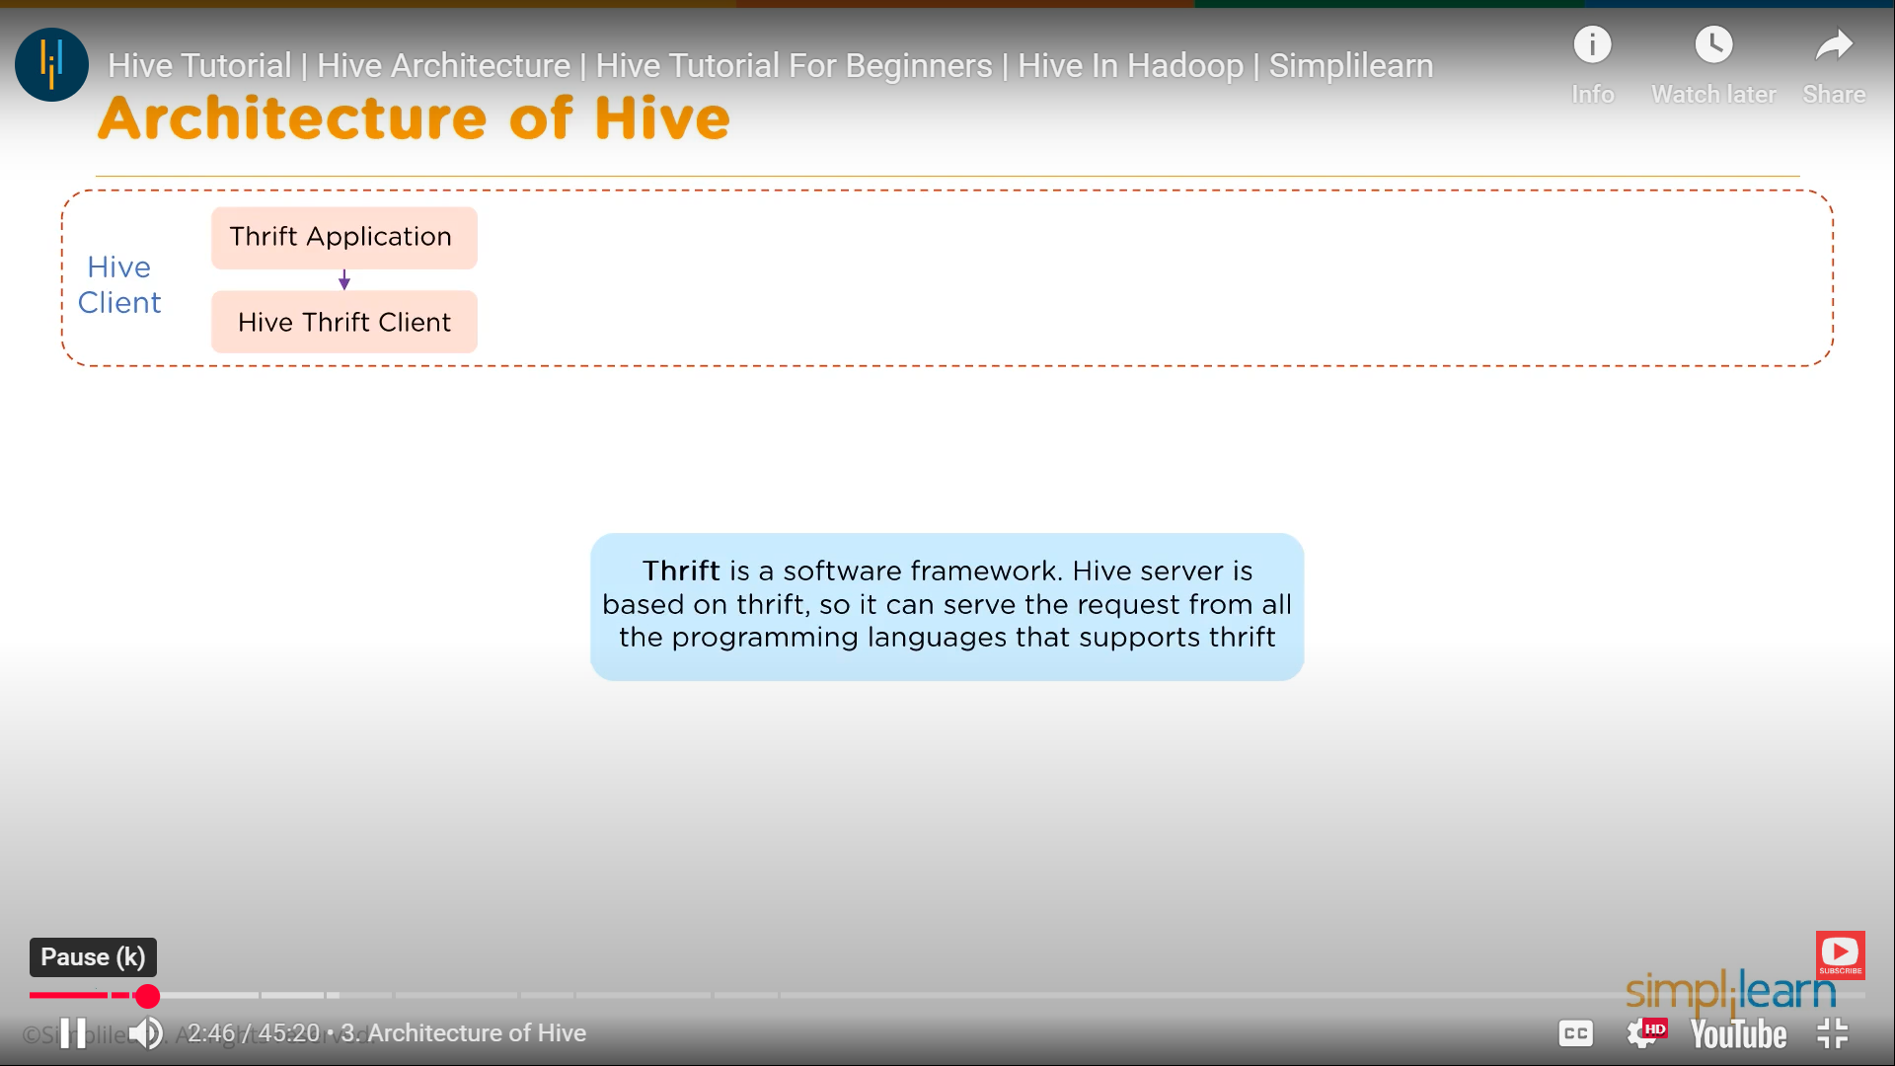


Slide 7
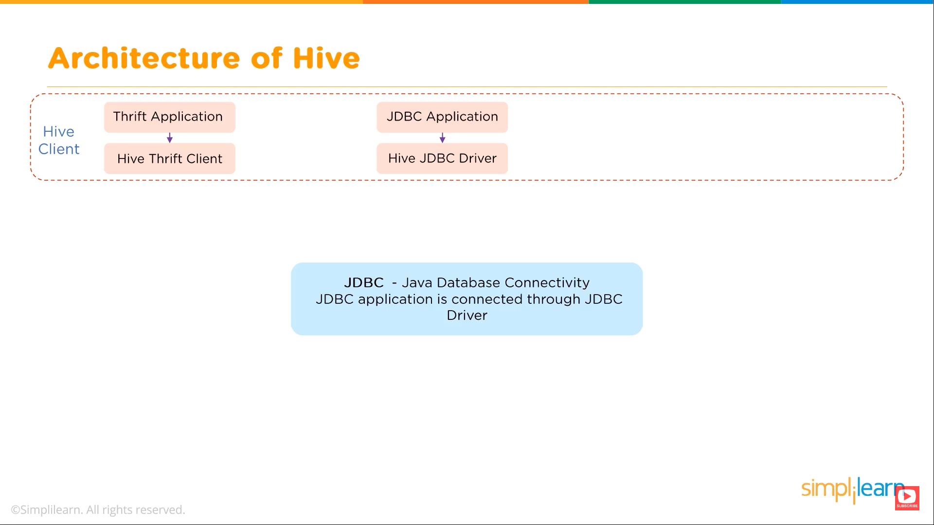

Slide 8
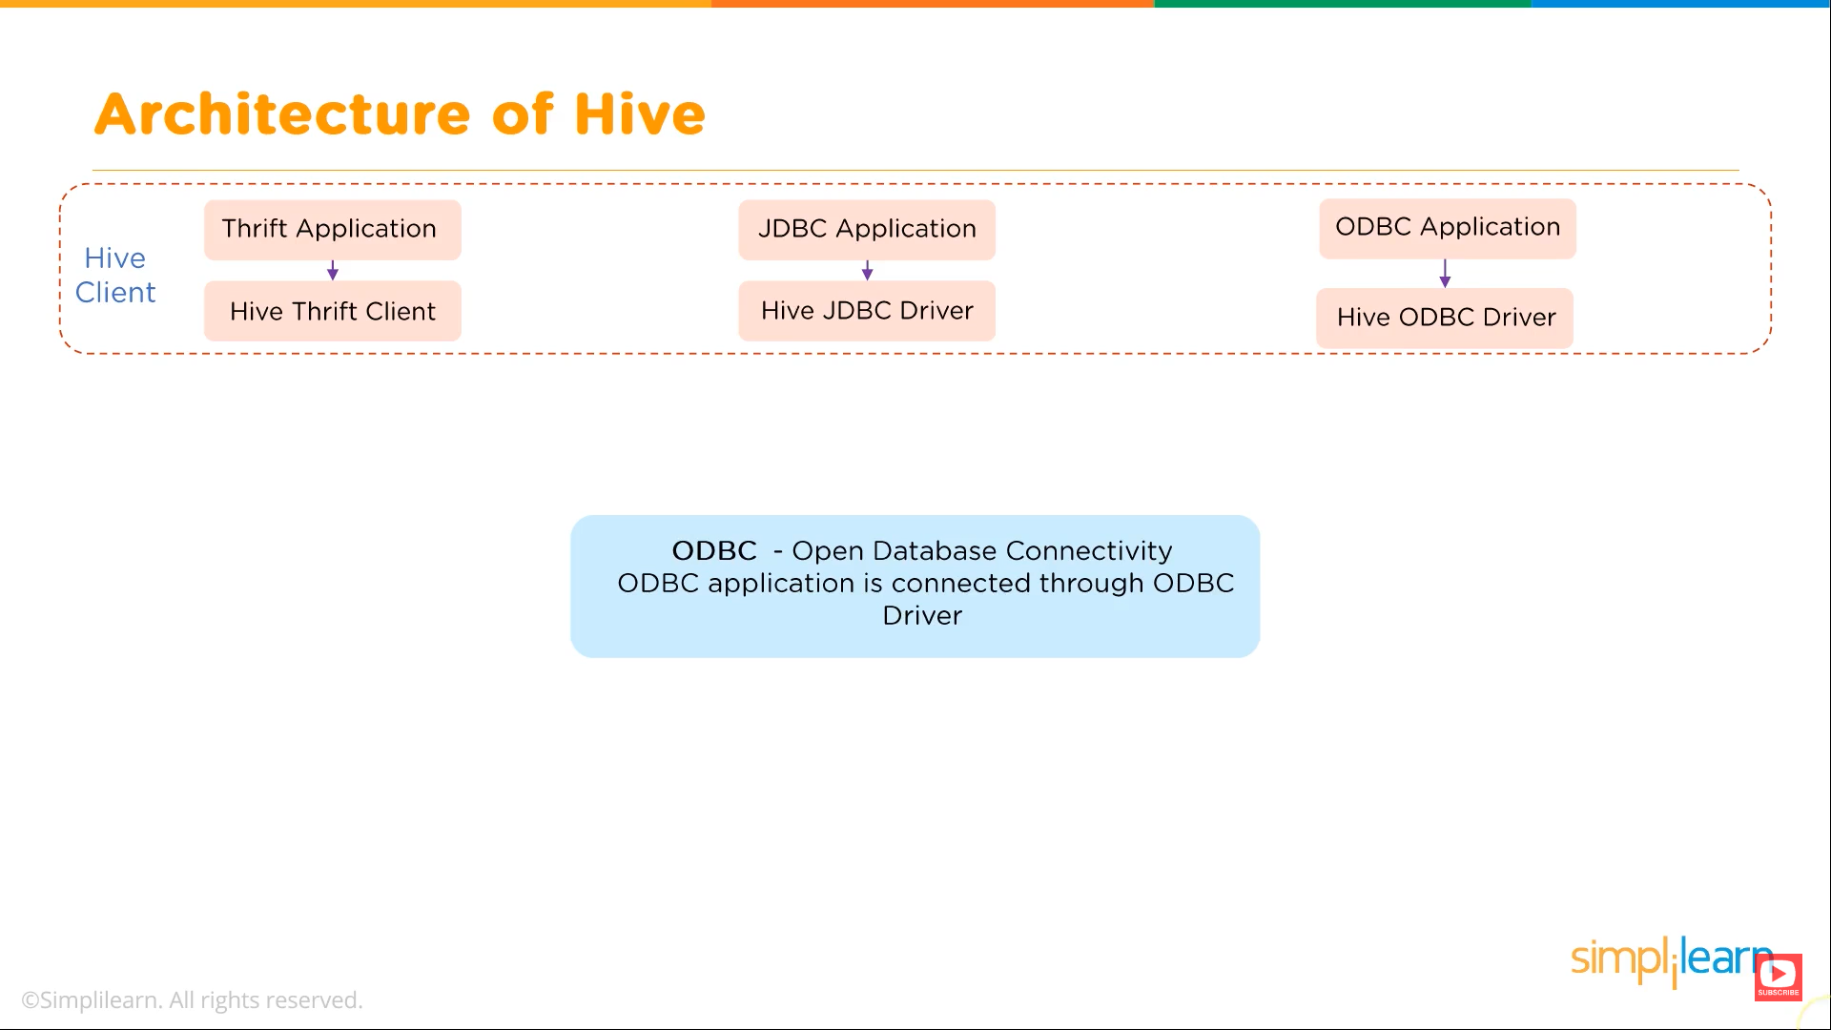

Slide 9
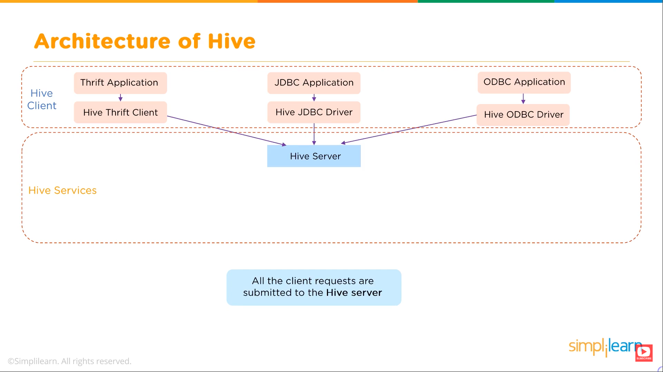

Slide 10
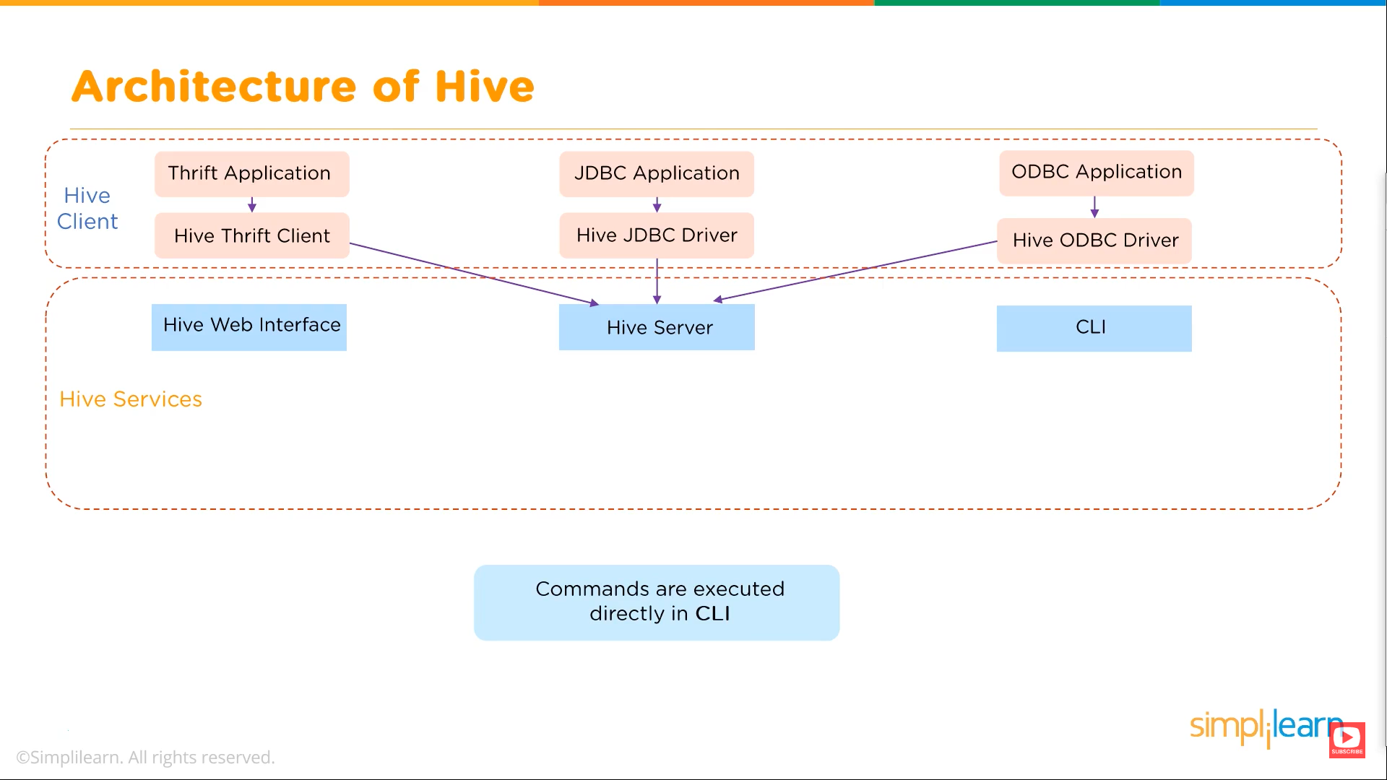

Slide 11
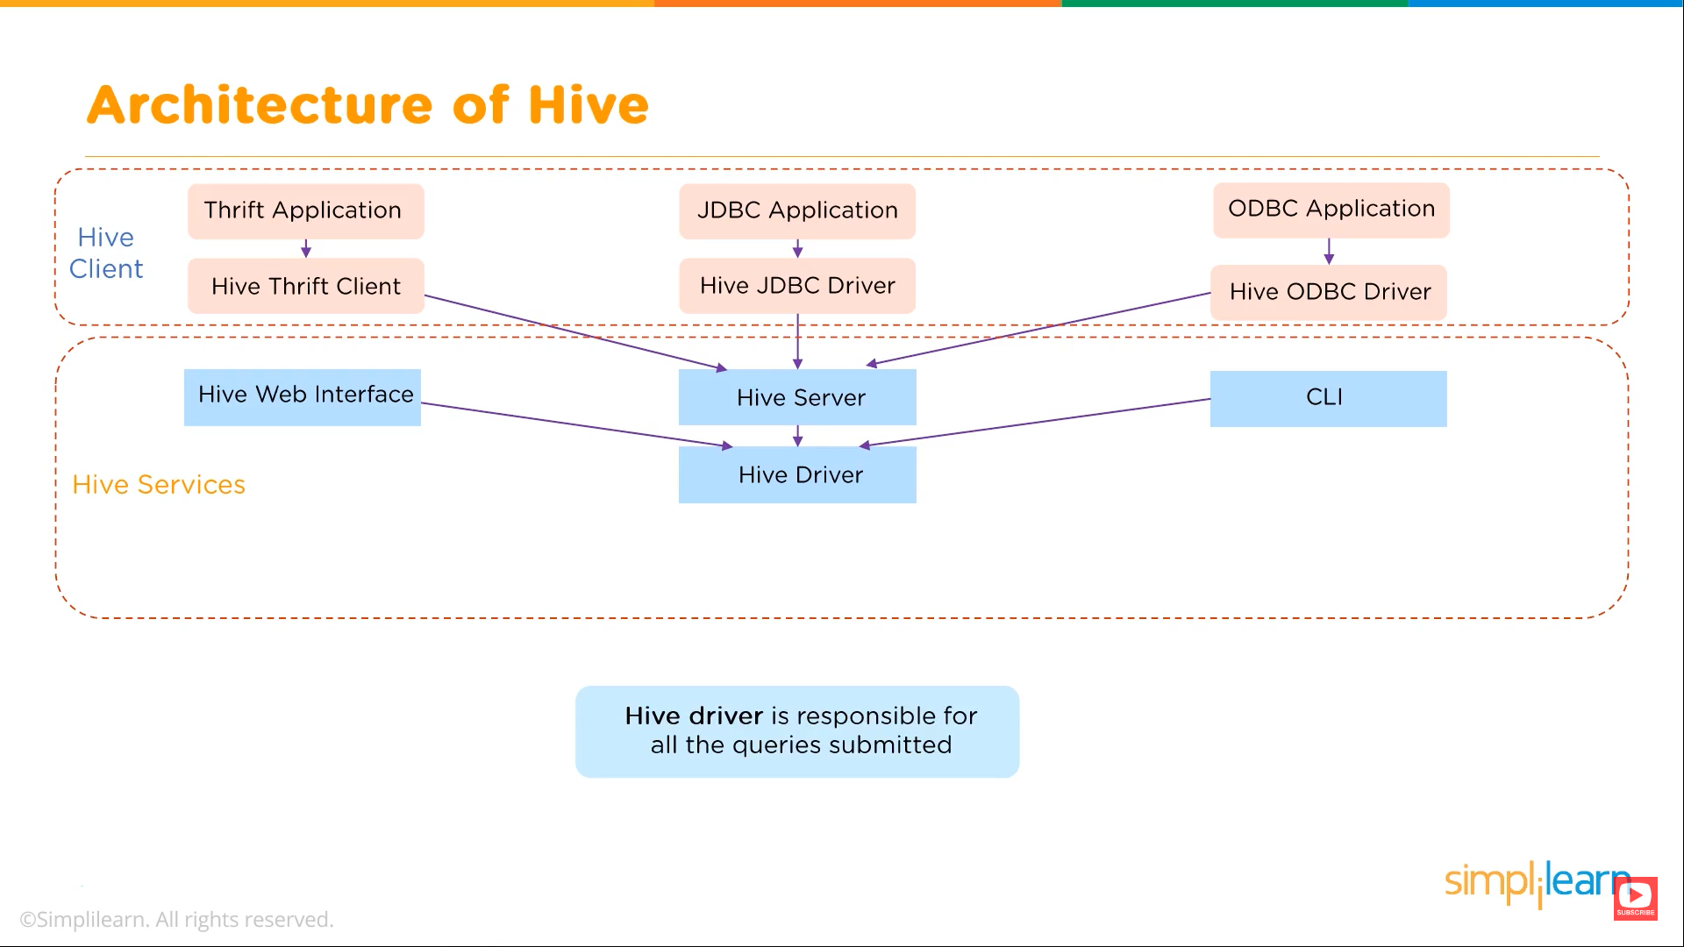

Slide 12
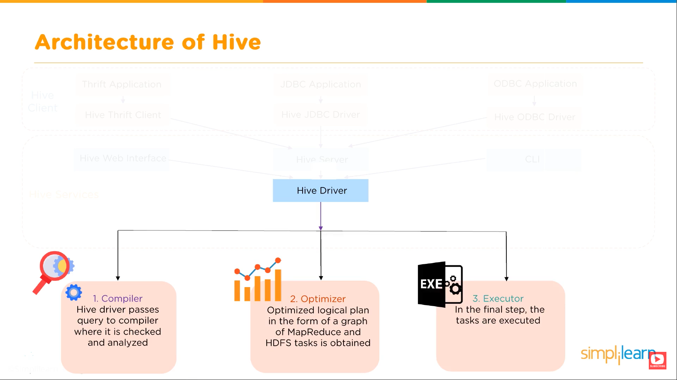

Slide 13
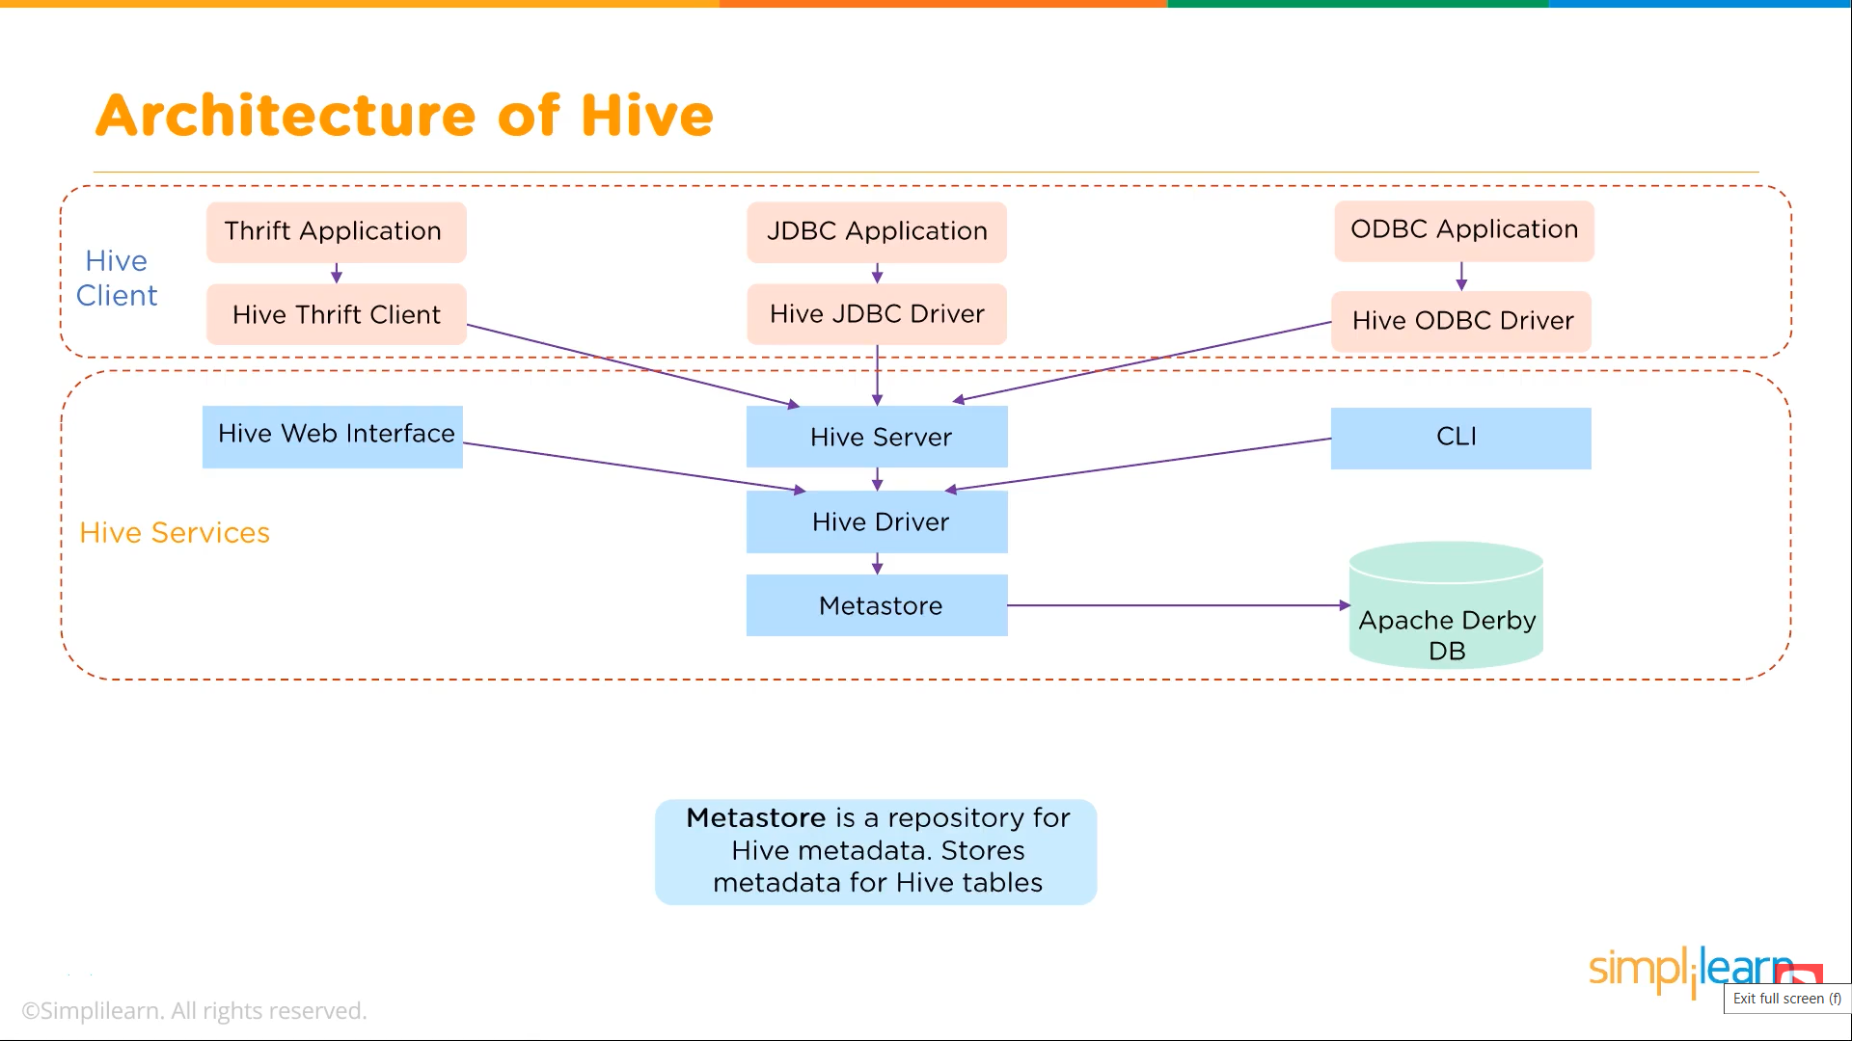

Slide 14
The data flow in the following sequence:
We execute a query, which goes into the driver
Then the driver asks for the plan, which refers to the query execution
After this, the compiler gets the metadata from the metastore
The metastore responds with the metadata
The compiler gathers this information and sends the plan back to the
driver
Now, the driver sends the execution plan to the execution engine
The execution engine acts as a bridge between the Hive and Hadoop to process the query
In addition to this, the execution engine also communicates
bidirectionally with the metastore to perform various operations, such as create and drop tables
Finally, we have a bidirectional communication to fetch and send results back to the client

Slide 15
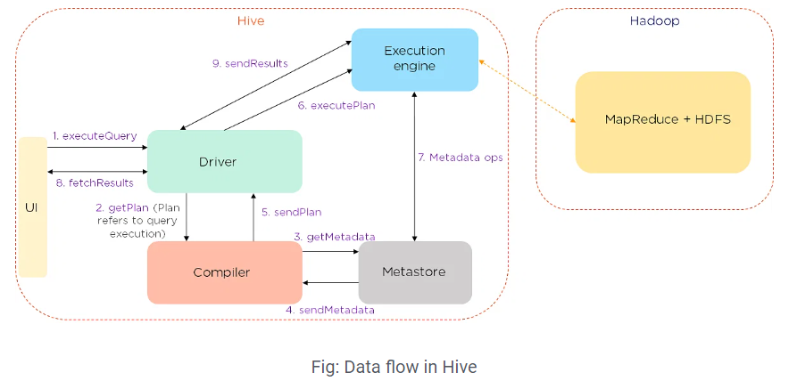

Slide 16
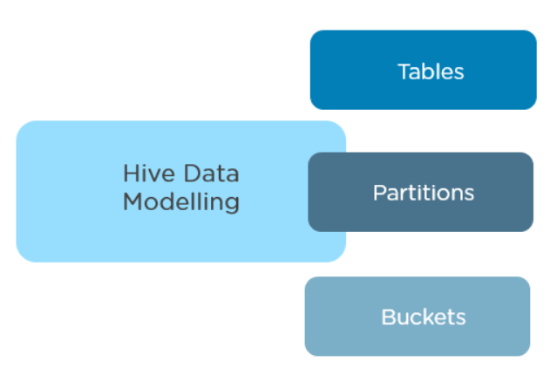
Tables - Tables in Hive are created the same way it is done in RDBMS
Partitions - Tables are organized into partitions for grouping similar types of data based on the partition key
Buckets - Data present in partitions can be further divided into buckets for efficient querying

Slide 17
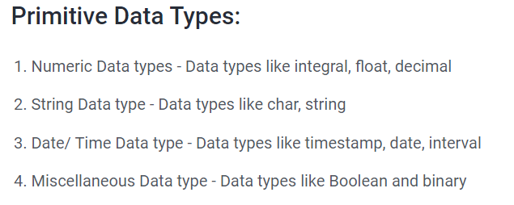
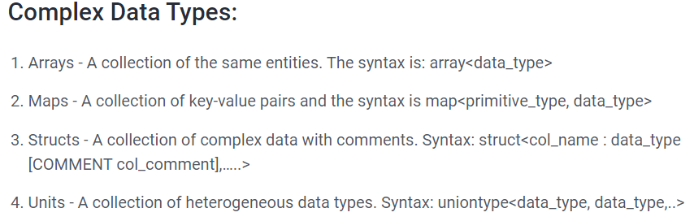
Hive Data Types

Slide 18
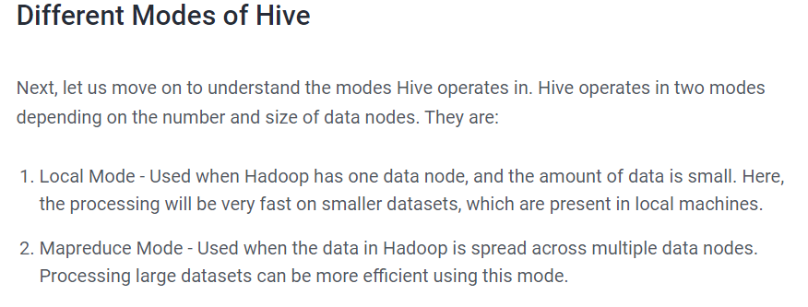

Slide 19
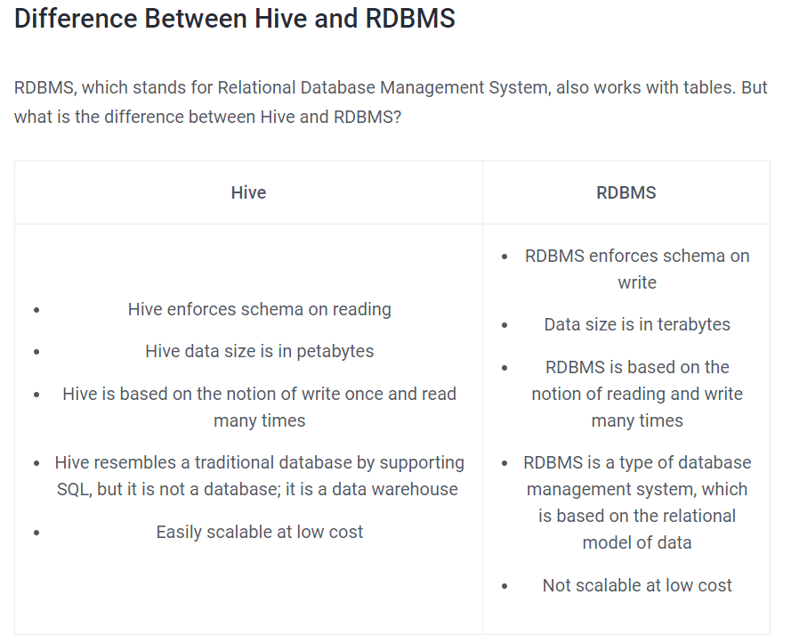

Slide 20
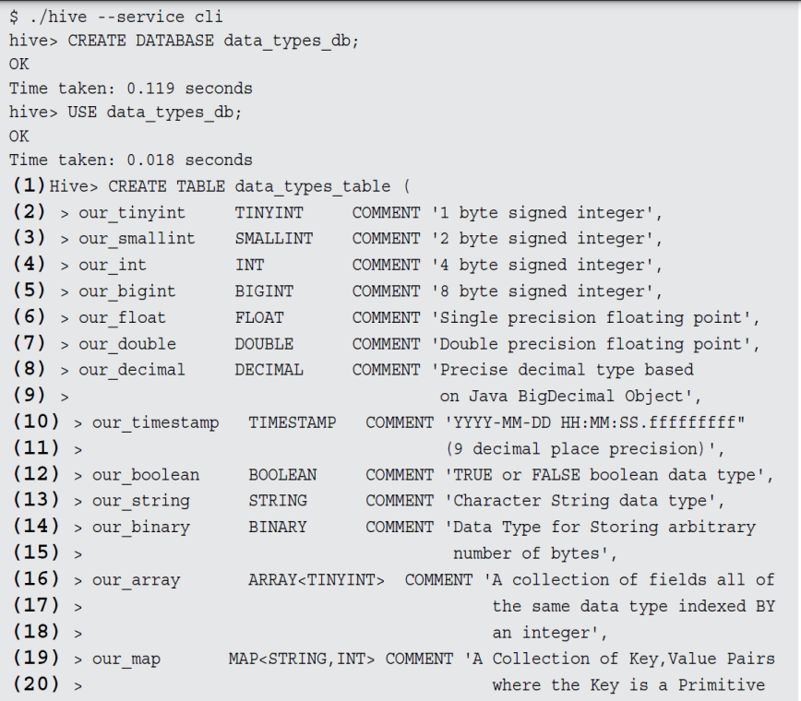
HIVE data Types (Primitive types, Conversions, Complex types)

Slide 21
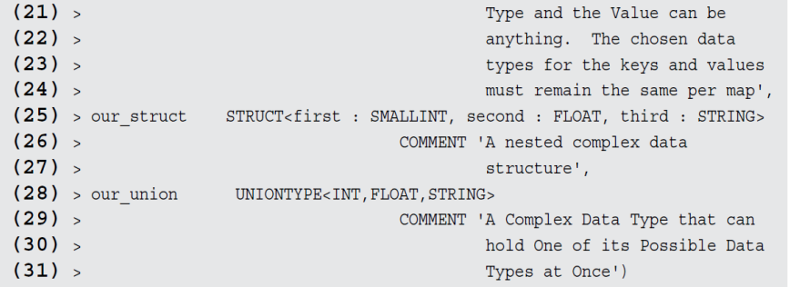
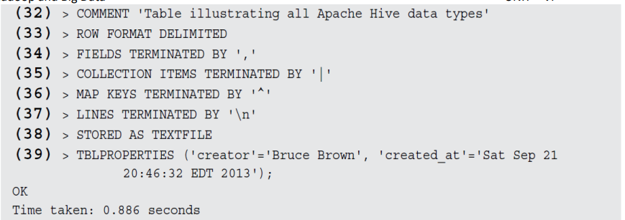

Slide 22
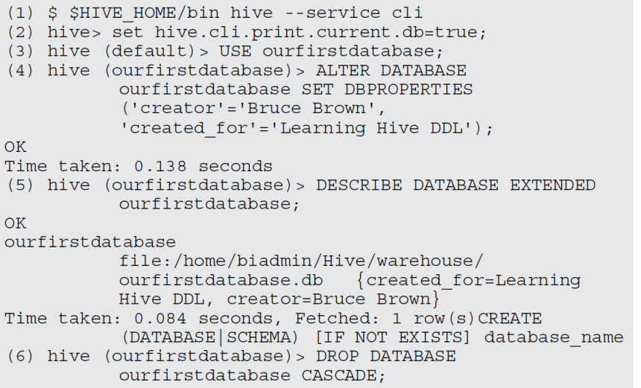
Creating and Managing Databases and Tables
Creating, Dropping, and Altering Databases

Slide 23
In Line 4 of above instructions,
we’re now altering the database which have already created with the name ourfirstdatabase to include two new metadata items: creator and created_for.
These two can be quite useful for documentation purposes and coordination within your working group.
The command in Line 5 is used to view the metadata.
With the help of command in Line 6 we’re dropping the entire database — removing it from the server.
We can use the DROP TABLE command to delete individual tables.

Slide 24
Creating and managing tables with Hive Apache Hive lets you define the record format separately from the file format. Hive tables default to the configuration in below Listing unless you override the default settings.
CREATE TABLE
...
...
ROW FORMAT DELIMITED
FIELDS TERMINATED BY '\001'
COLLECTION ITEMS TERMINATED BY '\002'
MAP KEYS TERMINATED BY ‘\003'
LINES TERMINATED BY ‘\n'
STORED AS TEXTFILE

Slide 25
The following listing specifies on how fields will be separated or delimited whenever you insert or load data into the table.
(1)Hive> CREATE TABLE data_types_table
( ... (33) > ROW FORMAT DELIMITED
(34) > FIELDS TERMINATED BY ','
(35) > COLLECTION ITEMS TERMINATED BY '|'
(36) > MAP KEYS TERMINATED BY '^'
(37) > LINES TERMINATED BY '\n'
(38) > STORED AS TEXTFILE
...
(39) > TBLPROPERTIES('creator'='Bruce Brown',
'created_at'='Sat Sep 21 20:46:32 EDT 2013');

Slide 26
In the above listing Lines 33–37 define the Hive row format for our data_types_table.
Line 38 defines the Hive file format — a text file — when the data is stored in the HDFS.
So far, we have been using the default TEXTFILE format for your Hive table records.
However, as you know, text files are slower to process, and they consume a lot of disk space unless you compress them.
For these reasons and more, the Apache Hive community came up with several choices for storing our tables on the HDFS.

Slide 27
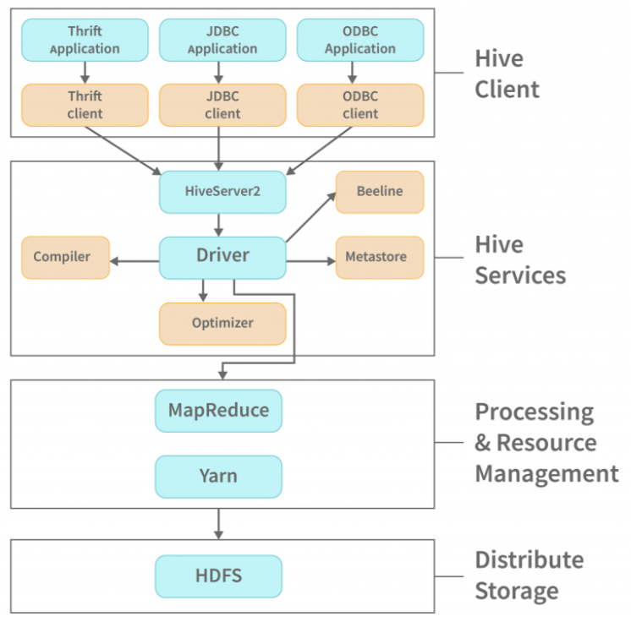

Slide 28
Hive Client:
Hive drivers support applications written in any language like Python, Java, C++, and Ruby, among others, using JDBC, ODBC, and Thrift drivers, to perform queries on the Hive. Therefore, one may design a hive client in any language of their choice.
The three types of Hive clients are referred to as :
Thrift Clients: The Hive server can handle requests from a thrift client by using Apache Thrift.
JDBC client: A JDBC driver connects to Hive using the Thrift framework. Hive Server communicates with the Java applications using the JDBC driver.
ODBC client: The Hive ODBC driver is similar to the JDBC driver in that it uses Thrift to connect to Hive. However, the ODBC driver uses the Hive Server to communicate with it instead of the Hive Server.

Slide 29
Hive Services:
Hive provides numerous services, including the Hive server2, Beeline, etc. The services offered by Hive are:
Beeline: HiveServer2 supports the Beeline, a command shell that which the user can submit commands and queries to. It is a JDBC client that utilises SQLLINE CLI (a pure Java console utility for connecting with relational databases and executing SQL queries). The Beeline is based on JDBC.
Hive Server 2: HiveServer2 is the successor to HiveServer1. It provides clients with the ability to execute queries against the Hive. Multiple clients may submit queries to Hive and obtain the desired results. Open API clients such as JDBC and ODBC are supported by HiveServer2.

Slide 30
Hive Driver: The Hive driver receives the HiveQL statements submitted by the user through the command shell and creates session handles for the query.
Hive Compiler: Metastore and hive compiler both store metadata in order to support the semantic analysis and type checking performed on the different query blocks and query expressions by the hive compiler. The execution plan generated by the hive compiler is based on the parse results.
The DAG (Directed Acyclic Graph) is a DAG structure created by the compiler. Each step is a map/reduce job on HDFS, an operation on file metadata, and a data manipulation step.

Slide 31
Optimizer: The optimizer splits the execution plan before performing the transformation operations so that efficiency and scalability are improved.
Execution Engine: After the compilation and optimization steps, the execution engine uses Hadoop to execute the prepared execution plan, which is dependent on the compiler’s execution plan.
Metastore: Metastore stores metadata information about tables and partitions, including column and column type information, in order to improve search engine indexing.
The metastore also stores information about the serializer and deserializer as well as HDFS files where data is stored and provides data storage. It is usually a relational database. Hive metadata can be queried and modified through Metastore.

Slide 32
We can either configure the metastore in either of the two modes:
Remote: A metastore is not enabled in remote mode, and non-Java applications cannot benefit from Thrift services.
Embedded: A client in embedded mode can directly access the metastore via JDBC.
Processing and Resource Management:
Hive uses a MapReduce framework as a default engine for performing the queries, because of that fact.
MapReduce frameworks are used to write large-scale applications that process a huge quantity of data in parallel on large clusters of commodity hardware. MapReduce tasks can split data into chunks, which are processed by map-reduce jobs.
Distributed Storage:
Hive is based on Hadoop, which means that it uses the Hadoop Distributed File System for distributed storage.

Slide 33
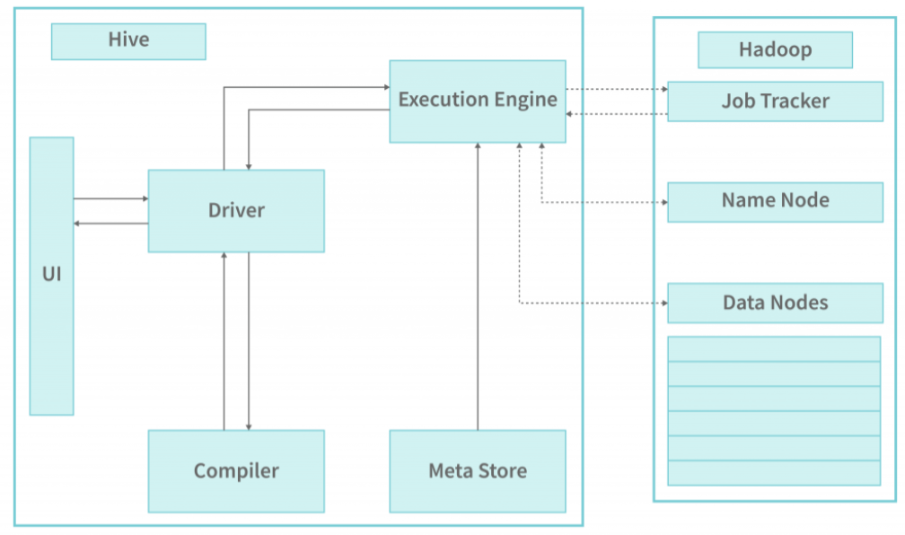
Working with Hive:

Slide 34
The driver calls the user interface’s execute function to perform a query.
The driver answers the query, creates a session handle for the query, and passes it to the compiler for generating the execution plan.
The compiler responses to the metadata request are sent to the metaStore.
The compiler computes the metadata using the meta data sent by the metastore. The metadata that the compiler uses for type-checking and semantic analysis on the expressions in the query tree is what is written in the preceding bullet. The compiler generates the execution plan (Directed acyclic Graph) for Map Reduce jobs, which includes map operator trees (operators used by mappers and reducers) as well as reduce operator trees (operators used by reducers).

Slide 35
5. The compiler then transmits the generated execution plan to the driver.
6. After the compiler provides the execution plan to the driver, the driver passes the implemented plan to the execution engine for execution.
7. The execution engine then passes these stages of DAG to suitable components. The deserializer for each table or intermediate output uses the associated table or intermediate output deserializer to read the rows from HDFS files. These are then passed through the operator tree. The HDFS temporary file is then serialised using the serializer before being written to the HDFS file system. These HDFS files are then used to provide data to the subsequent MapReduce stages of the plan. After the final temporary file is moved to the table’s location, the final temporary file is moved to the table’s final location.
8. The driver stores the contents of the temporary files in HDFS as part of a fetch call from the driver to the Hive interface. The Hive interface sends the results to the driver.

Slide 36
Different Modes of Hive:
A hive can operate in two modes based on the number of data nodes in Hadoop.
Local mode
Map-reduce mode
When using Local mode:
We can run Hive in pseudo mode if Hadoop is installed under pseudo mode with one data node.
In this mode, we can have a data size of up to one machine as long as it is smaller in terms of physical size.
Smaller data sets will be processed rapidly on local machines due to the processing speed of small data sets.

Slide 37
When using Map Reduce mode:
In this type of setup, there are multiple data nodes, and data is distributed across different nodes. We use Hive in this scenario
It will be able to handle large amounts of data as well as parallel queries in order to execute them in a timely fashion.
By turning on this mode, you can increase the performance of data processing by processing large data sets with better performance.

